Slide 1

DSP Final Project
Messy Bedroom Classification
Group member: Zhenglong Wu
Qian Wang
Xinyu Jiang
Bingrui Yang

Slide 2
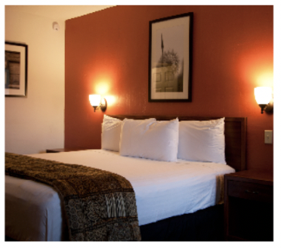
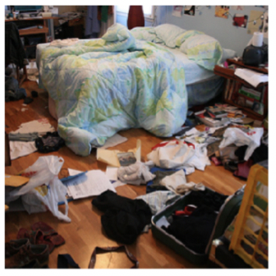
Feature Engineering
Clean Room
Messy Room

Slide 3
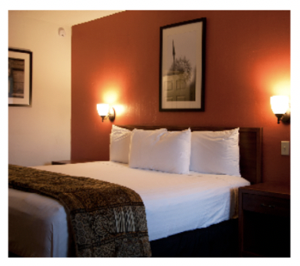
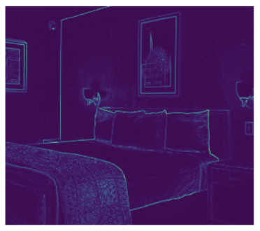
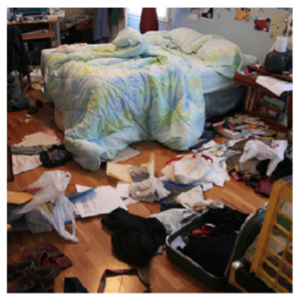
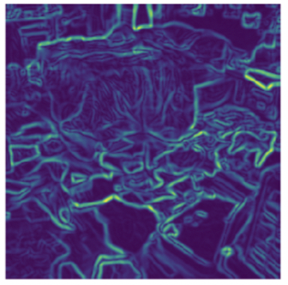

Slide 4

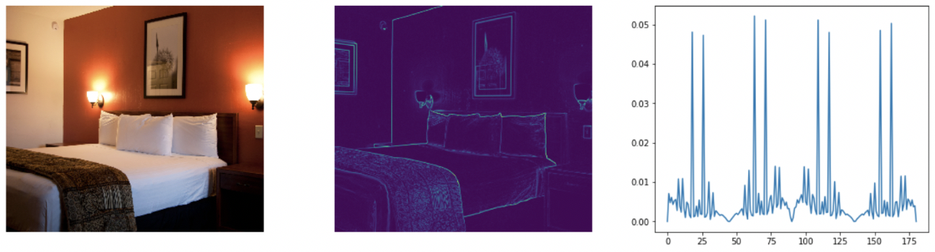
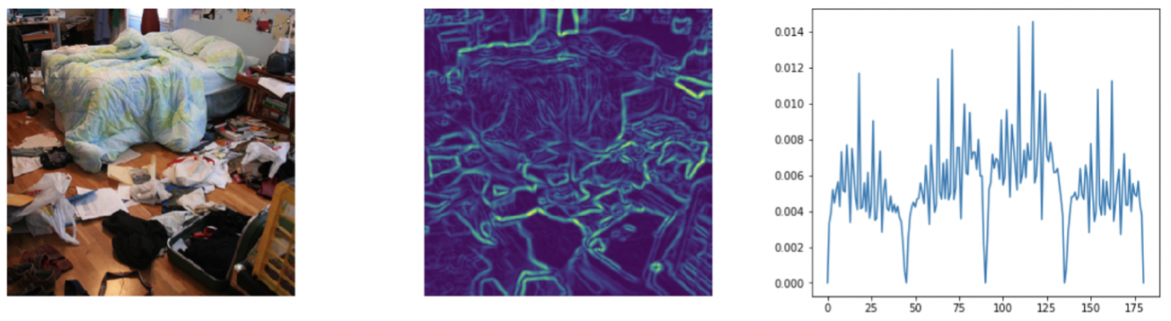

Slide 5
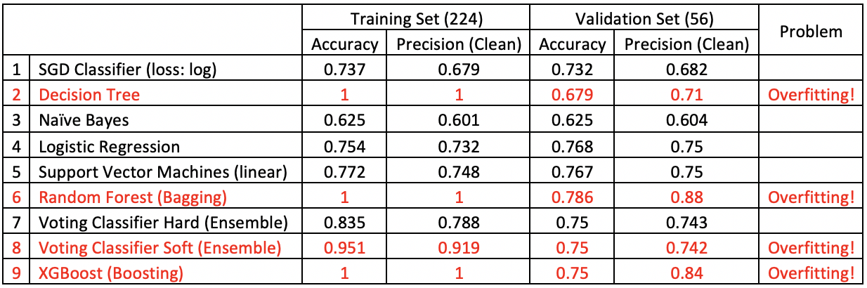
Model Comparison

Slide 6
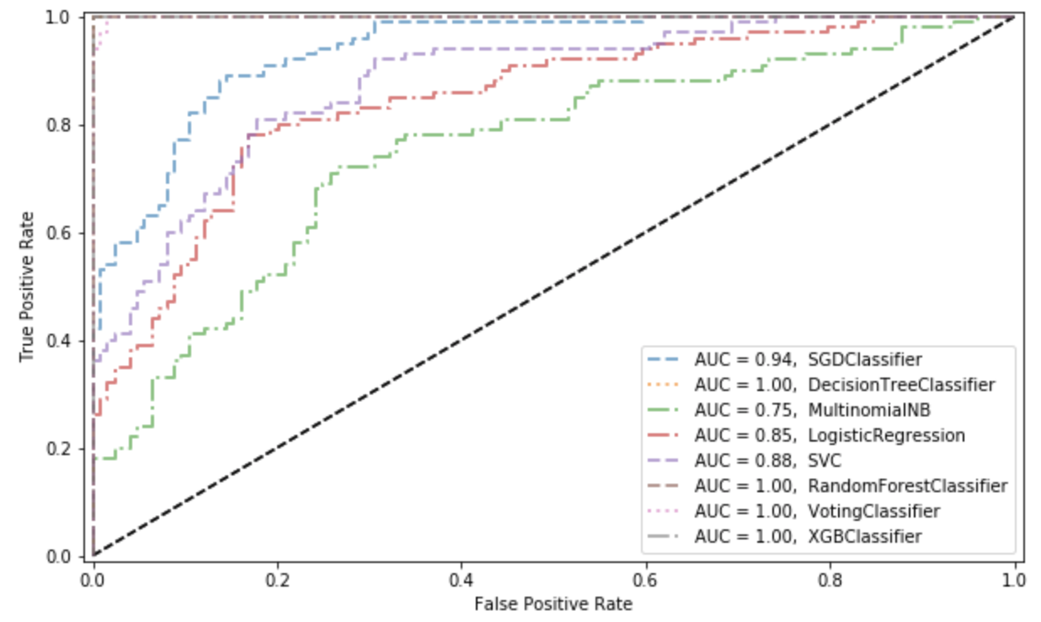
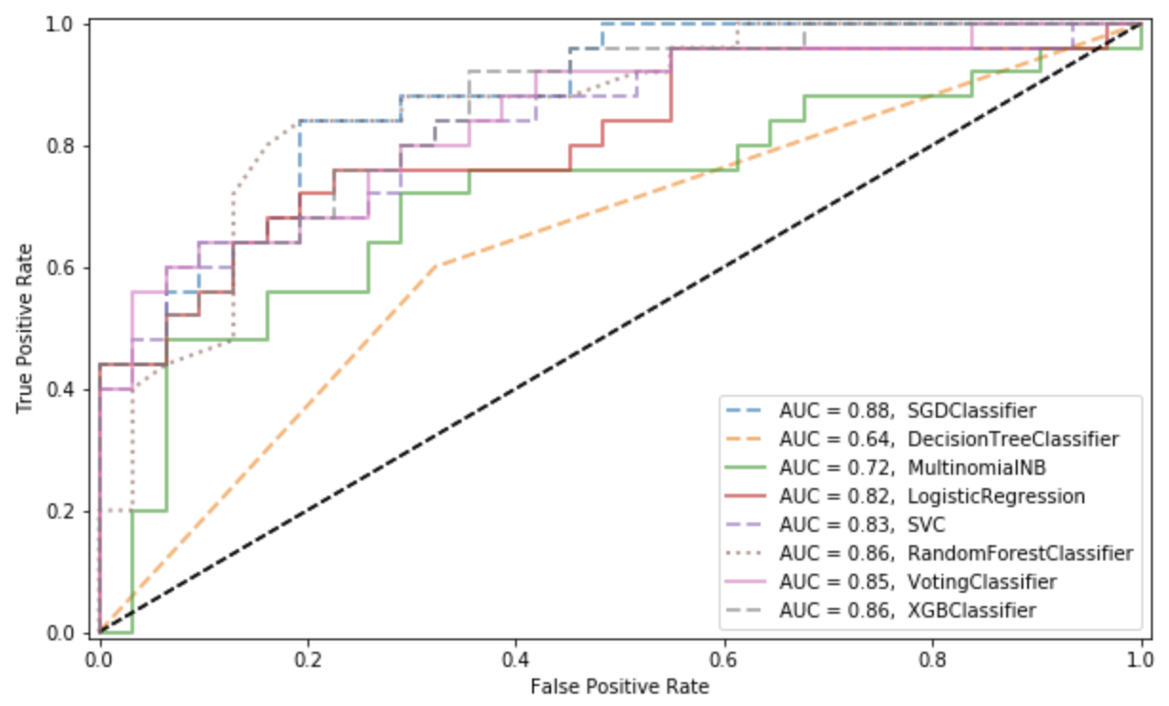
ROC Curve
Training Set
Validation Set

Slide 7
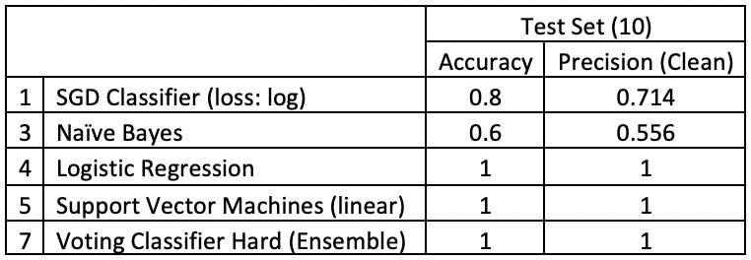
Prediction

Slide 8
CNN Models
Baseline Model
Model with Data Augmentation & Regularizations
VGG16 Transfer Learning

Slide 9
Regularization Techniques
l2 regularization
Dropout
Early stopping

Slide 10
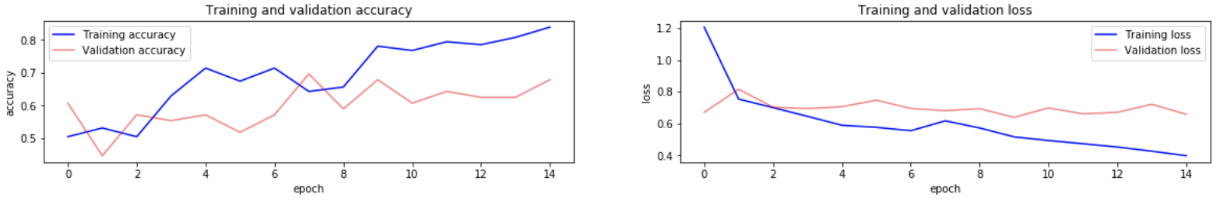
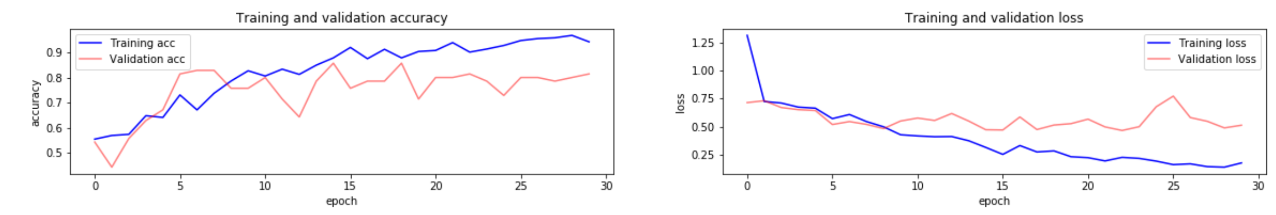
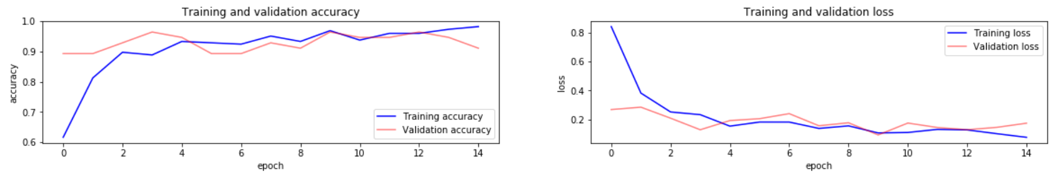
Loss and Accuracy

Slide 11
Statistical Model Summary
Models | Training Accuracy | Validation Accuracy
Baseline | 83.93% | 67.86%
Regularized | 94% | 81.43%
VGG16 | 95.09% | 92.86%

Slide 12
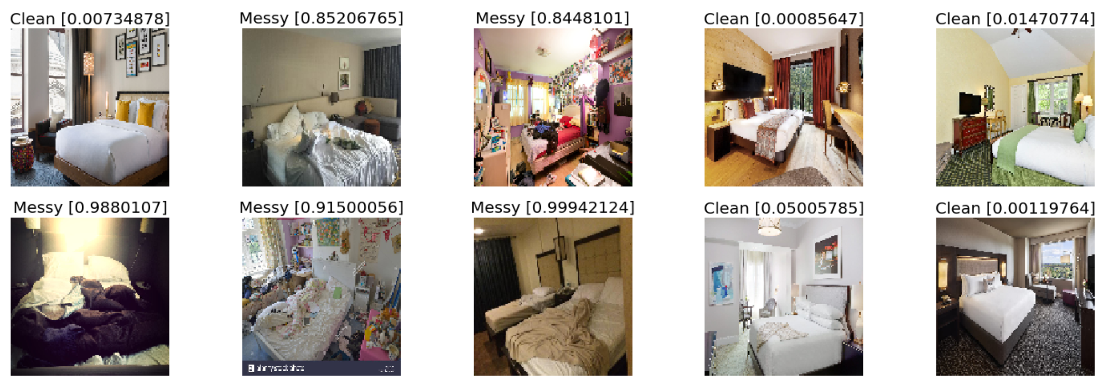
Prediction

Slide 13
Thank you ☺

